Slide 1
Behavior, Distribution, and Passage Metrics of Juvenile Salmonids for Detroit Dam
Tobias Kock, John Beeman, Amy Hansen, and Hal Hansel
Western Fisheries Research Center
Columbia River Research Laboratory
5501A Cook-Underwood Road
Cook, Washington 98605
Study Code: JPL-11-03-DET

Slide 2
Study Area
Background/Methods
Results
Summary/Questions
Portland
Wilsonville
Willamette Falls Dam
WILLAMETTE RIVER
Salem
Juvenile Chinook salmon
JSATS and PIT-tagged
Minto Dam
Big Cliff Dam
Bennett Dam
NORTH SANTIAM RIVER
Detroit Dam
Detroit Reservoir
SOUTH SANTIAM RIVER

Slide 3
Objectives
Background/Methods
Results
Summary/Questions
#3: Passage and PIT-tag detection
Willamette Falls Dam
#2: Route of passage
Minto
Dam
#1: Passage survival
Bennett
Dam
Detroit
Dam

Slide 4
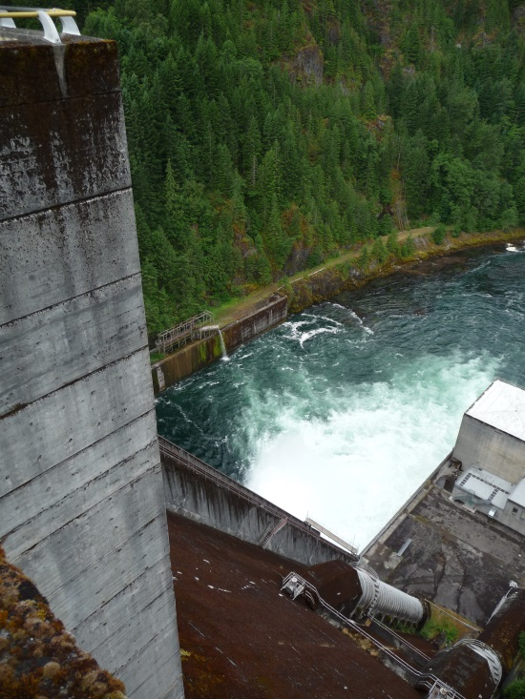
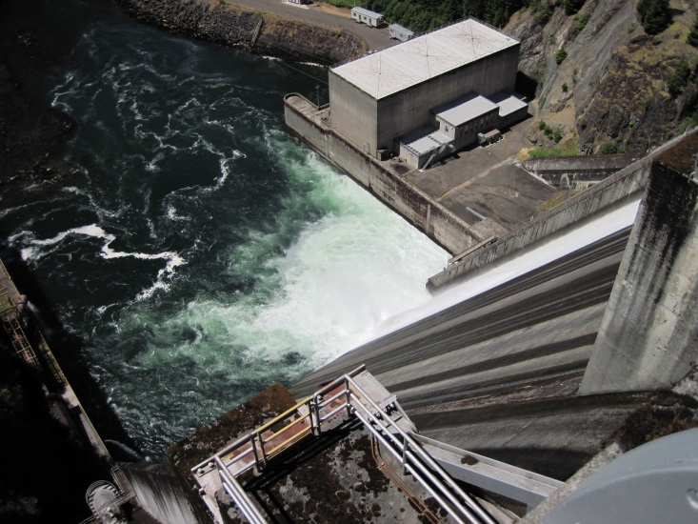
Objective 1: Passage Survival at Detroit Dam
Background/Methods
Results
Summary/Questions
Fish Benefit Workbook
  19 – 65%
  Varies by lifestage, operational scenario
  Chitaro et al., 2013
Balloon Tag Study
  54% - turbines
  84% - spillway
  94% - RO
  Normandeau and Associates, 2010
PIT-tag Study
  ≈ 86%
  High passage during period of spill
  Friesen and Johnson, 2013

Slide 5
PIT-tag Detections at Willamette Falls Dam
Background/Methods
Results
Summary/Questions
Tailrace-release
Reservoir-release
Spill at
Detroit
Dam
Figure modified from Friesen and Johnson, 2013

Slide 6
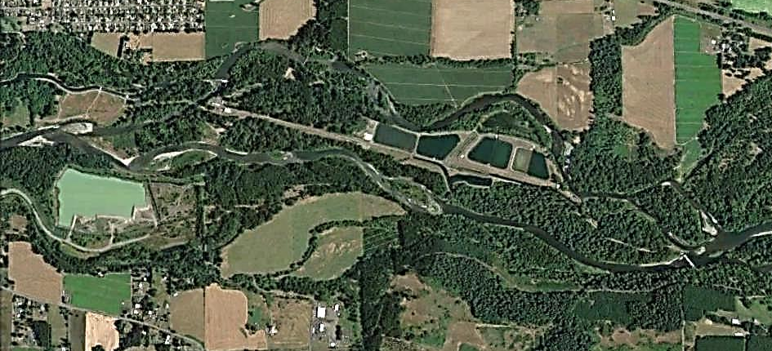
Objective 2: Describe Passage at Bennett Dam
Background/Methods
Results
Summary/Questions
Stayton Canal
Lower Bennett
Dam
Upper Bennett
Dam
Background image from Google Earth

Slide 7
Objective 2: Describe Passage at Bennett Dam
Background/Methods
Results
Summary/Questions
Background image from Google Earth

Slide 8
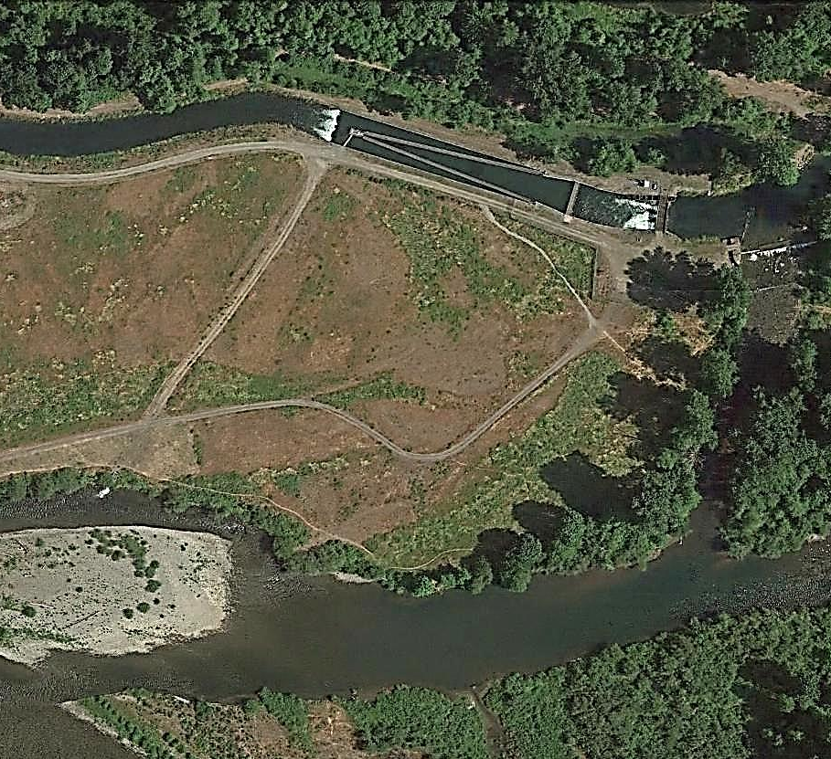
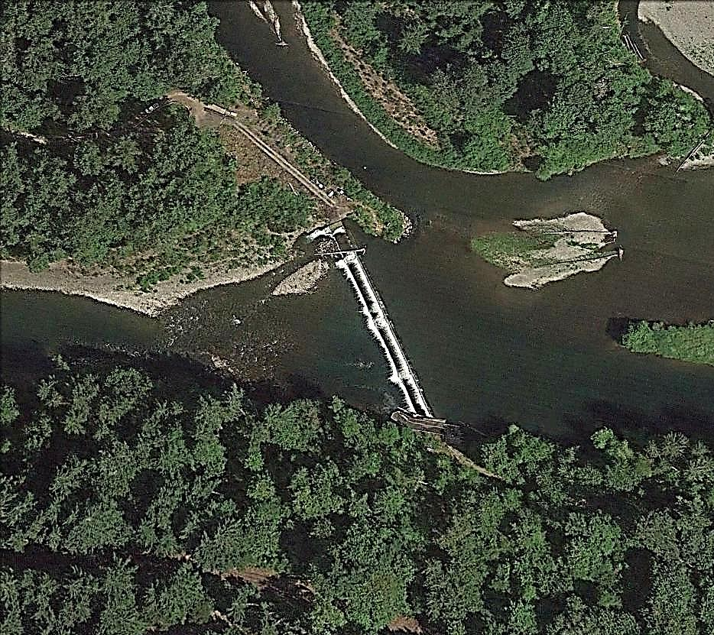
Objective 2: Describe Passage at Bennett Dam
Background/Methods
Results
Summary/Questions
Stayton Canal
Upper Bennett Dam
JSATS receiver
PIT-tag antennas
PIT-tag antennas
JSATS receivers (2)
Background image from Google Earth

Slide 9
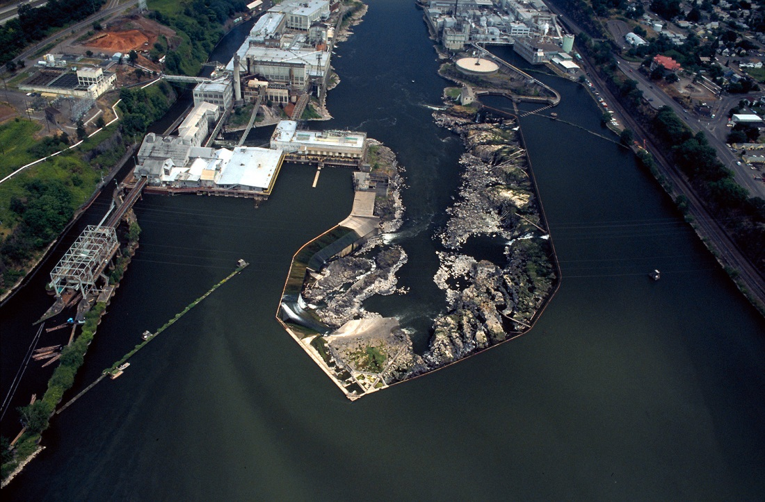
Objective 3: Determine the Probability of Passage and PIT-tag Detection at Willamette Falls Dam
Background/Methods
Results
Summary/Questions

Slide 10
Tagging and Release
Background/Methods
Results
Summary/Questions
Treatment fish
Control fish
n ≈ 10,000
n ≈ 10,000
Subyearling Chinook salmon
Marion Forks Hatchery
PIT-tagged in late June
Fish size:
  JSATS treatment group
    102.7 mm (95-123 mm)
    13.0 g (8.8-23.6 g)
  JSATS control group
    102.7 mm (95-116 mm)
    12.8 g (6.9-19.3 mm)
Tag info:
  JSATS transmitters
    0.31 g
    15 sec PRI
    90% taglife = 82.1 d
Tag burden:
  JSATS + PIT-tag = 0.41 g
  Mean burden = 3.3% (1.7 – 5.9%)
n=997
JSATS-tagged
in early August
n=625
Released Aug. 11
Head of Detroit Reservoir
Data in Presentation
Aug. 11 – Oct. 28
Released Sept. 17
Minto Dam Tailrace

Slide 11
Detection Locations
Background/Methods
Results
Summary/Questions
Portland
Wilsonville
Willamette Falls Dam
= JSATS sites
= PIT-tag sites
Salem
Bennett Dam
Minto
Dam
Big Cliff
Dam
Detroit Dam

Slide 12
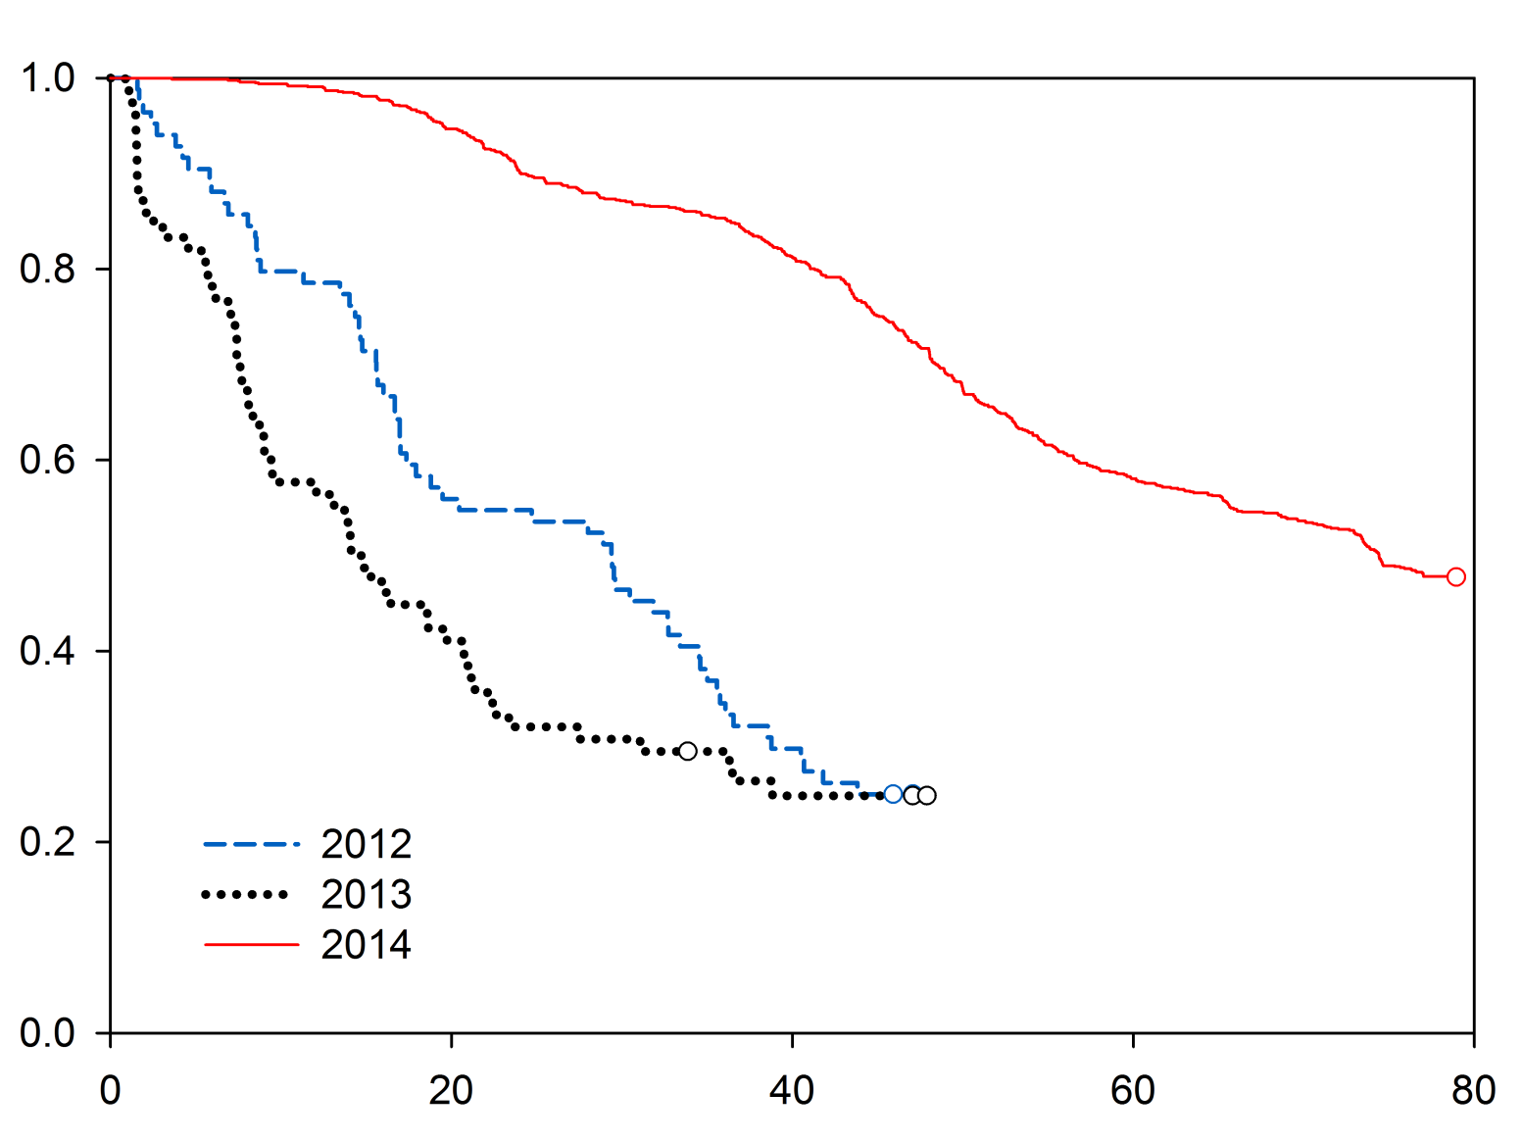
Travel Time in Detroit Reservoir
Background/Methods
Results
Summary/Questions
August release
Proportion of fish in dam forebay
44 of 997 fish (4.4%) passed dam
Dam passage survival not estimated
September releases
Travel time (d)

Slide 13
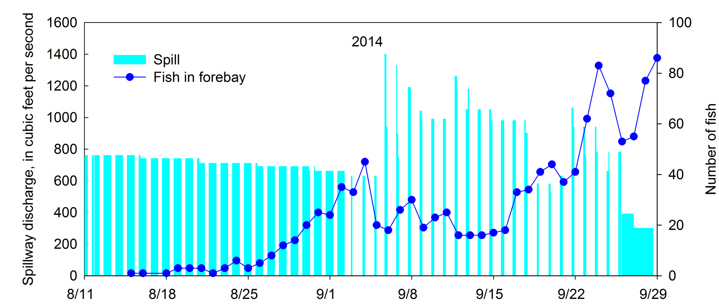
Spill and Near Dam Detections
Background/Methods
Results
Summary/Questions
10 fish
passed
4 fish
passed
Spillway discharge (ft³/sec)
Number of tagged fish in forebay
15 hrs/day
(3 pm – 6 am)
5 hrs/day
(5 pm – 9 pm)
Notes:
15 OF 997 FISH RELEASED IN 2014
0 OF 78 FISH RELEASED IN 2013
5 OF 84 FISH RELEASED IN 2012

Slide 14
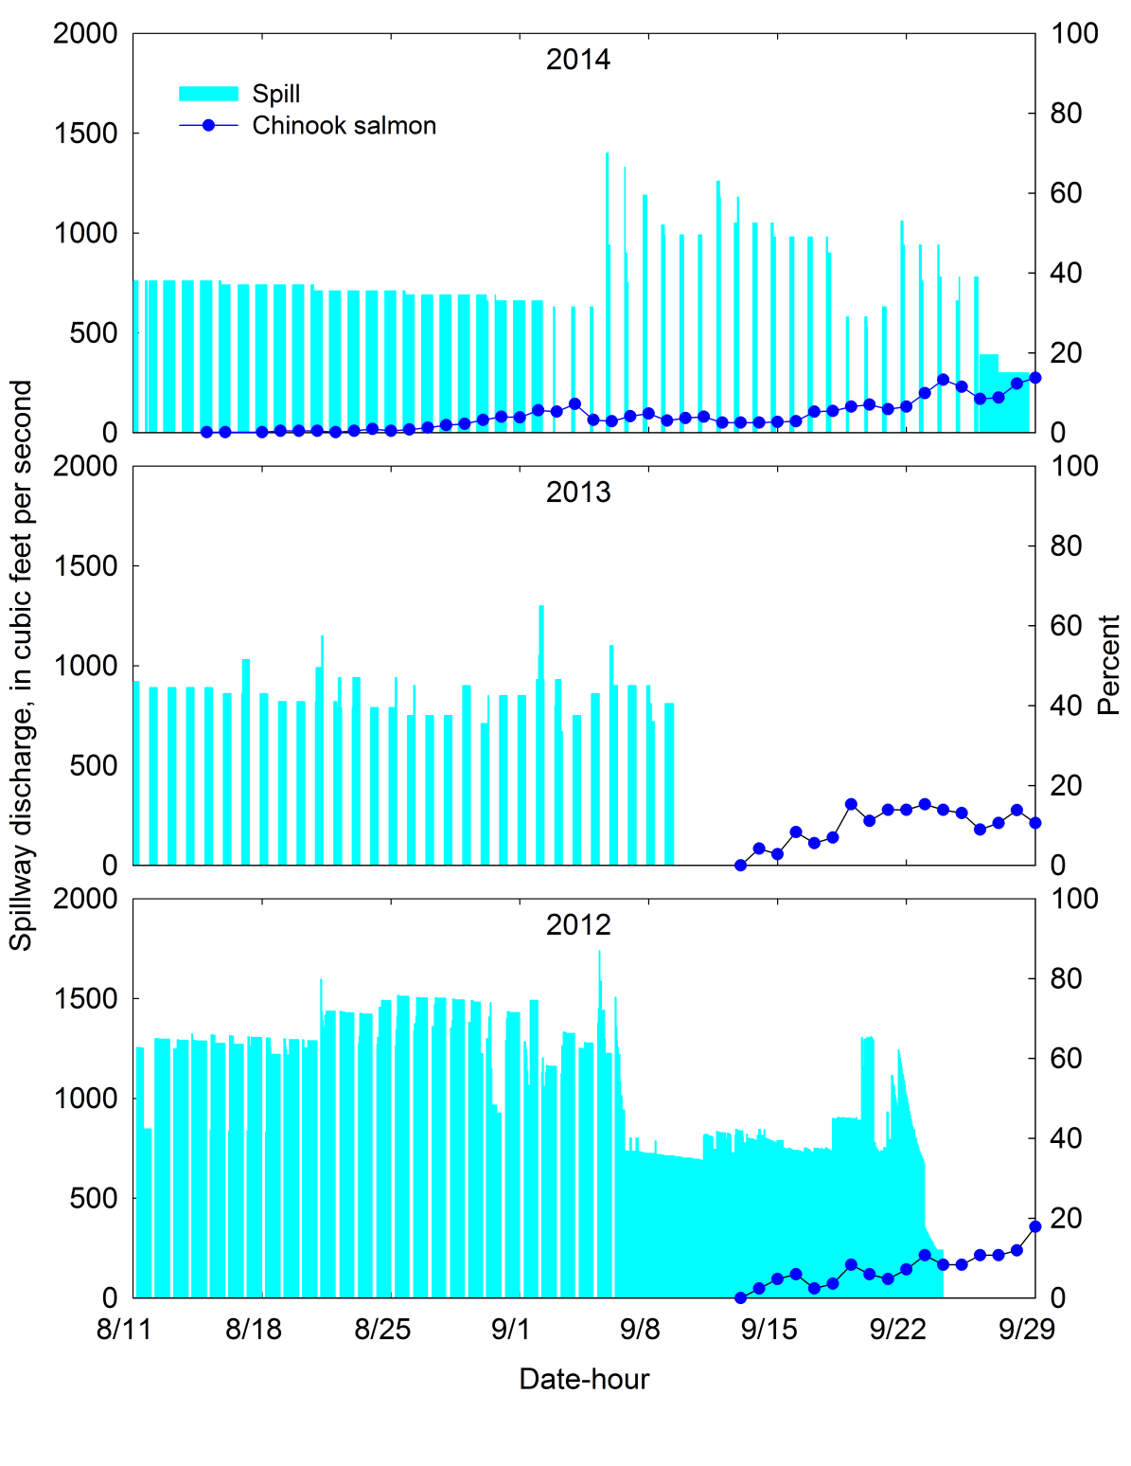
Spill and Near Dam Detections
Background/Methods
Results
Summary/Questions
% Dam Passage
1.5%
Spillway discharge (ft³/sec)
0.0%
Percent of fish in forebay
6.0%
Notes:
15 OF 997 FISH RELEASED IN 2014
0 OF 78 FISH RELEASED IN 2013
5 OF 84 FISH RELEASED IN 2012

Slide 15
Passage at Bennett Dam Complex
Background/Methods
Results
Summary/Questions
625 fish
released
in Minto
Dam
tailrace
402 fish (64%)
arrived at
Bennett Dam
complex by
Oct. 28
Background image from Google Earth

Slide 16
Passage at Bennett Dam Complex
Background/Methods
Results
Summary/Questions
248 fish (62%) passed at
Stayton Canal
145 fish (36%) passed via other routes
9 fish (2%) “passed” at Upper Bennett Dam
Background image from Google Earth

Slide 17
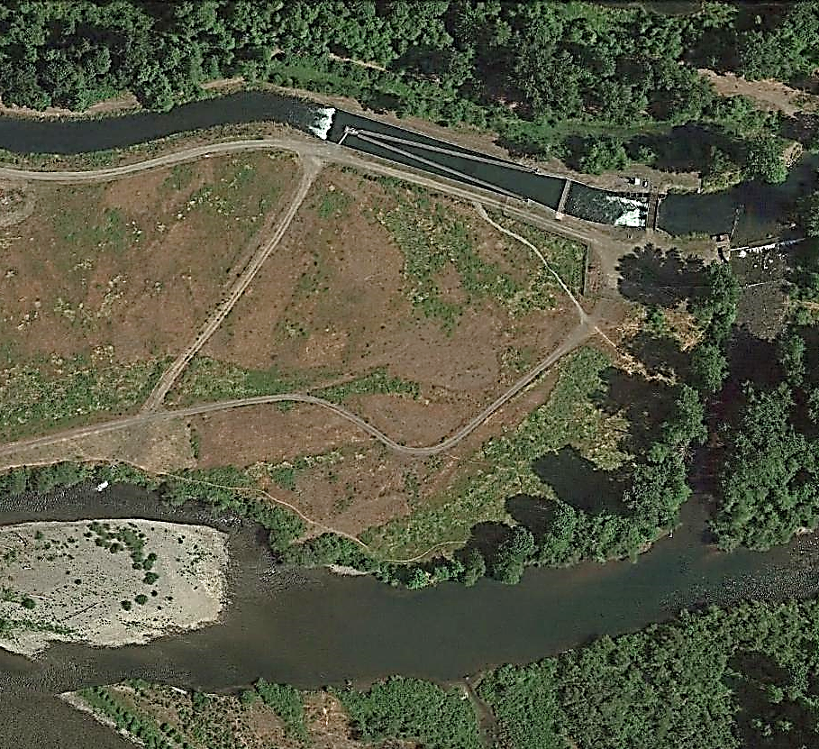
Residence Time in the Stayton Canal
Background/Methods
Results
Summary/Questions
Median residence time = 6.5 h
80% of fish passed in < 1d
14% of fish had residence times
that ranged from 7 – 37 d
Background image from Google Earth

Slide 18
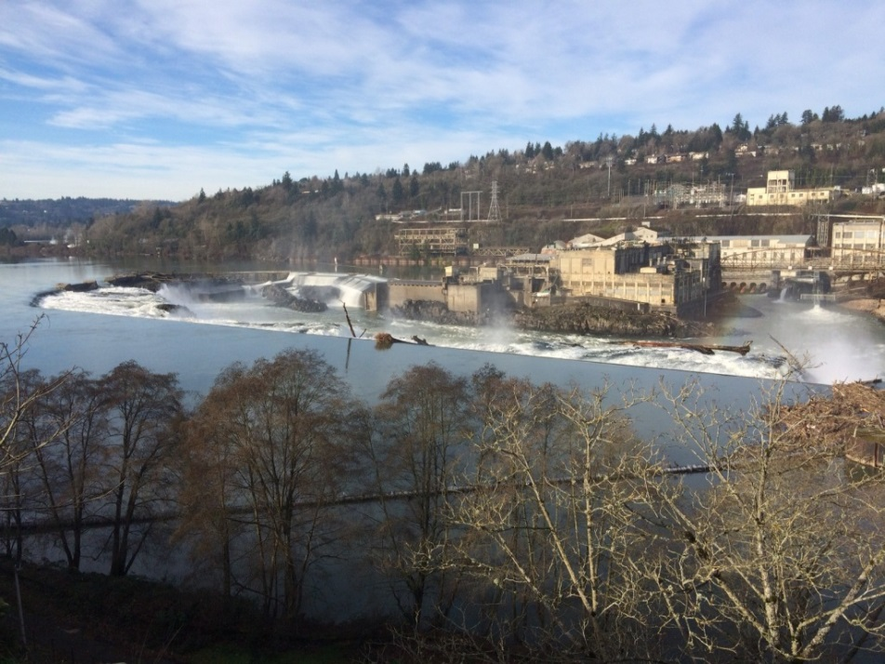
Probability of Passage and Detection at Willamette Falls Dam
Background/Methods
Results
Summary/Questions
Portland
n = 98 fish
Wilsonville
n = 136 fish
Willamette Falls Dam
p = 0.449
95% c.i.
0.354 – 0.548

Slide 19
Period of Fish Passage
Background/Methods
Results
Summary/Questions
Passage of JSATS fish at Willamette Falls Dam
Flow (ft³/sec)
Date
Maximum daily flows at Portland (Gage # 14211720)

Slide 20


Passage Routes and Flow
Background/Methods
Results
Summary/Questions

Slide 21
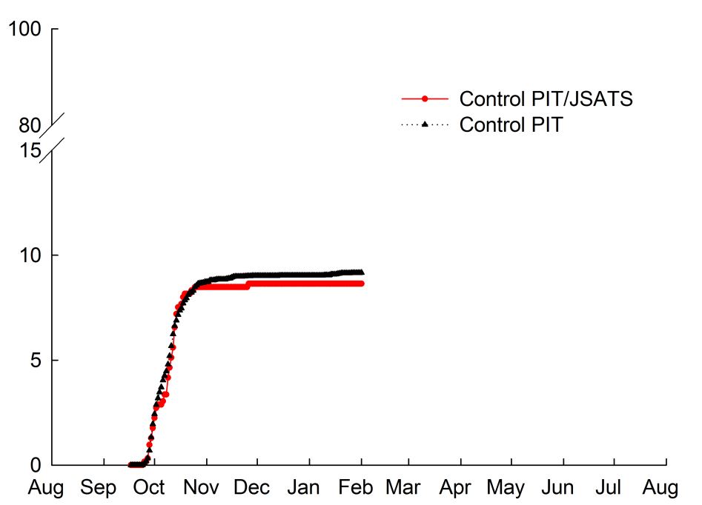
Additional Data
Background/Methods
Results
Summary/Questions
Friesen and Johnson, 2013
USGS, 2014
Percent cumulative detections

Slide 22
Summary
Background/Methods
Results
Summary/Questions
Low passage at Detroit Dam
  Reservoir travel times > 20 d for most fish
  Spillway operations appeared to affect passage
  <5% of tagged fish passed dam – dam passage
  survival not estimated
Fish used multiple passage routes
at Bennett Dam
  2% passed at Upper Bennett Dam
  62% passed near Stayton Power Canal
  Some fish delayed 7-37 days in canal
Willamette Falls Dam passage and detection probability
≈ 45% during study
  Estimate from September/October 2014
  Flow range during estimation period = 22,500 ft³/sec to 49,000 ft³/sec

Slide 23
Acknowledgements
Background/Methods
Results
Summary/Questions
USACE
  Bob Wertheimer and Scott Fielding
  Chris Walker and Mary Karen Scullion
ODFW
  Tom Friesen, Derrek Faber, and Greg Grenbemer
  Chris Boyd, Matt Lessard, Rick Madsen and the rest of the
  Marion Forks Hatchery staff
Staff at Detroit, Big Cliff, Minto, Bennett, and Willamette Falls Dams
USGS
  Columbia River Research Laboratory staff
USFS, Detroit Ranger District
  Boat and equipment storage

Slide 24
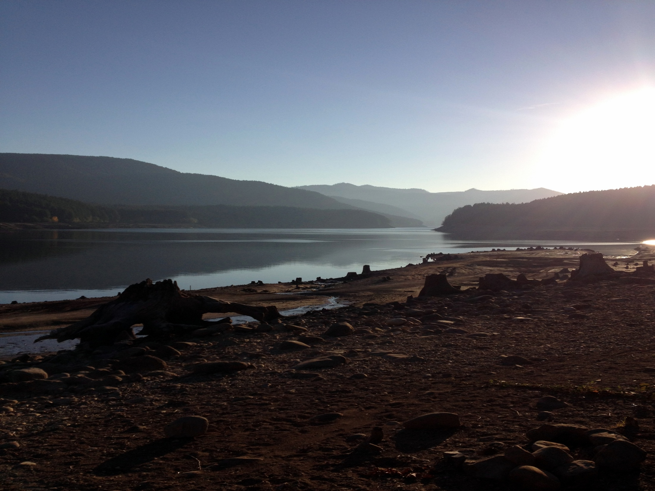
Background/Methods
Results
Summary/Questions

Slide 25
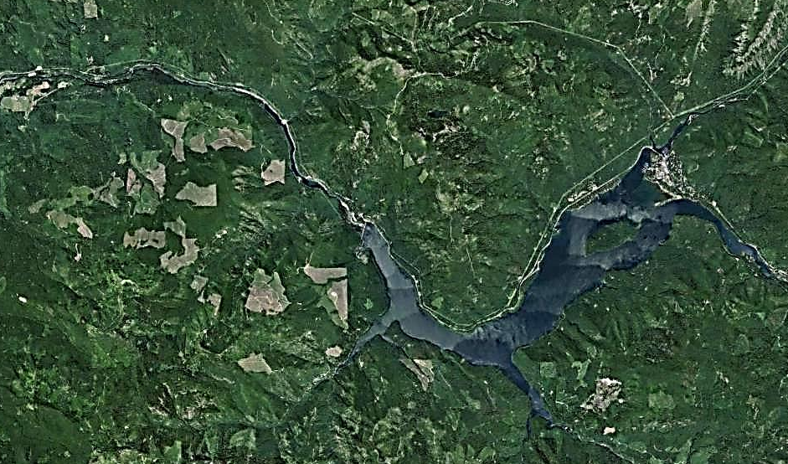
Paired Release Recapture Study Design
Background/Methods
Results
Summary/Questions
Minto
Dam
Control
release
(n=625)
Detroit
Dam
Goal for Downstream Fish Movement
Equal #’s of treatment and control fish
Overlapping migration period
Treatment
release
(n=997)
Background image from Google Earth

Slide 26
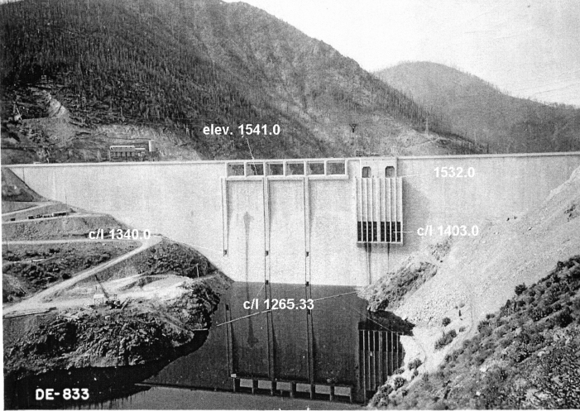
Temperature Control Spill in Late Summer
Background/Methods
Results
Summary/Questions
Spillway
Turbines
SUITABLE
TEMPERATURE
UNSUITABLE
TEMPERATURE

